Slide 1


Tej Courier Service COURIER DATABASE MANAGEMENT SYSTEM
Bhavya Dubey(202018049)
Harman Singh(202018050)
Hardik Shah(202012097)
Daksh Vatyani(202012098)
Chiranjeev Rajpurohit(202012099)
Adarsh Kumar Maheshwari(202012100)

Slide 2
Functional Requirements
Company have several branches that can be identified by branch name and ID, branch also have a location(Address) and contact information.
The Courier sender and receiver have a unique ID, Name (first name and last name), contact information, and address.
A branch calculate a uniform rate for each distance, weight, and type of courier , and it generates payment details which consists of mode of payment and other transaction related details.
Employees are assigned designation which includes name of position and salary , they also manage couriers.
If the courier is not delivered to receiver then it is returned to the branch and is sent back to the sender.
Link for further Functional Requirements: Functional Requirments

Slide 3
ER Model
ER Diagram
Link: ERD (Click here to open)

Slide 4
Relational Model
Relational Diagram
Link :- Relational Diagram(Click here to open)

Slide 5
SQL DDL Statement
SQL DDL
Link: SQL-DDL(Click here to open)

Slide 6
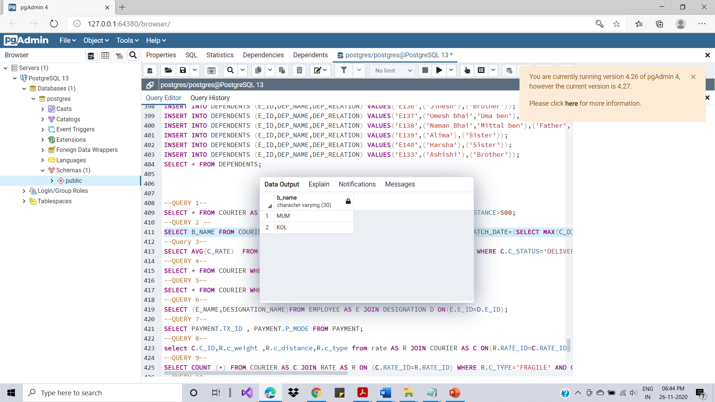
Functional Requirement-1
1. Name of the branch which sent the maximum number of courier in month of August.
Link: FR1(Click here to open)

Slide 7
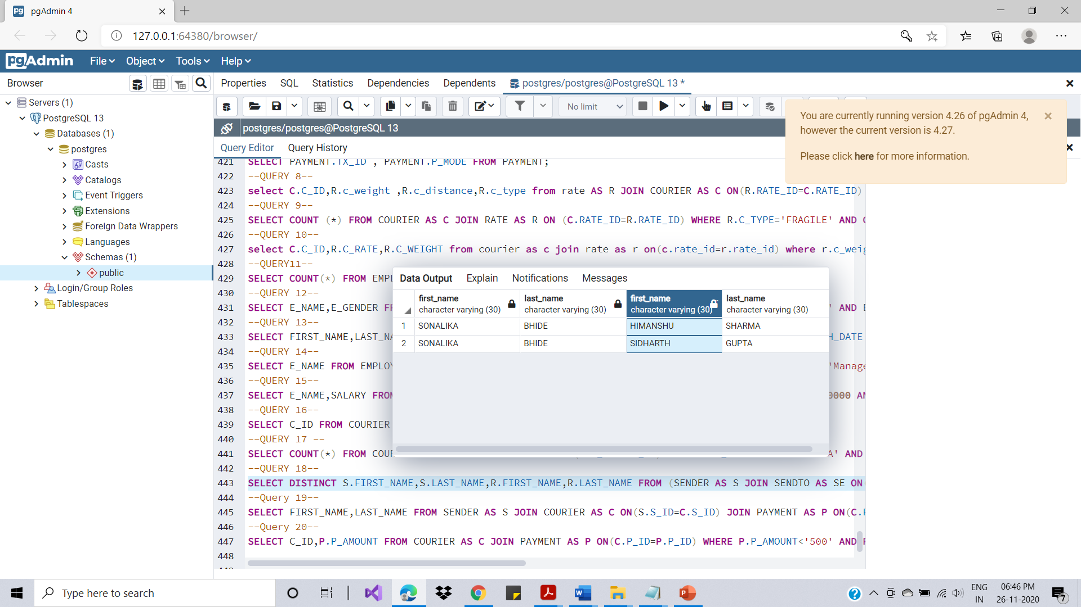
Functional Requirement-2
2. To retrieve courier's sender and receiver name whose STATUS is SUCCESSFUL.
Link: FR2(Click here to open)

Slide 8
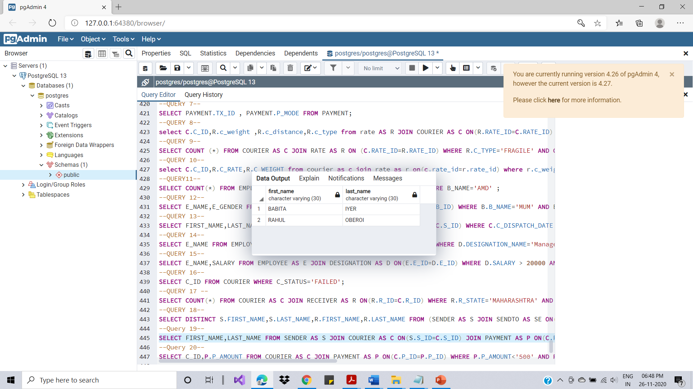
Functional Requirement-3
3. Select name of customers whose mode of payment is offline and courier status is In transit.
Link: FR3(Click here to open)

Slide 9
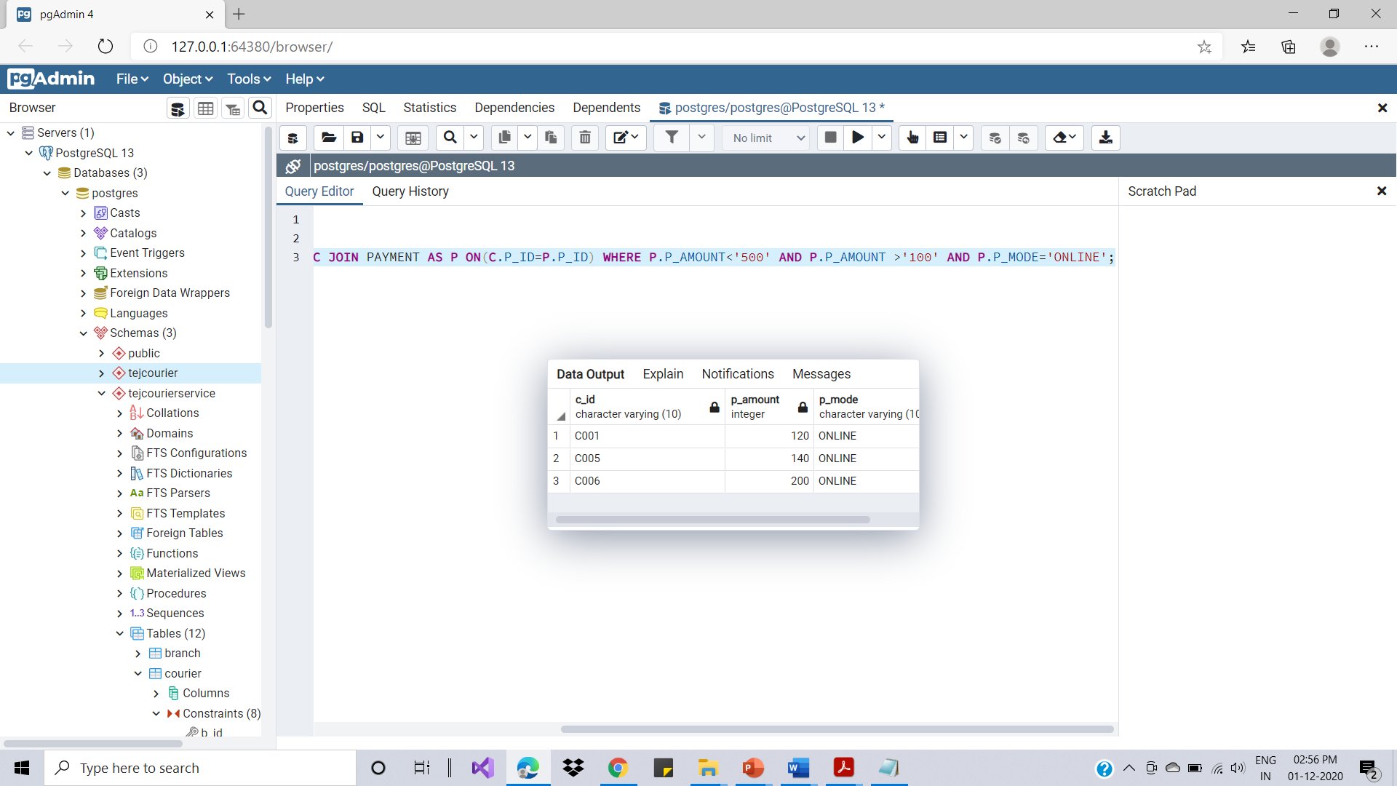
Functional Requirement-4
4. Select all the courier whose cost is greater than Rs 100 and less than Rs 500 & mode of payment is online.
Link: FR4(Click here to open)

Slide 10
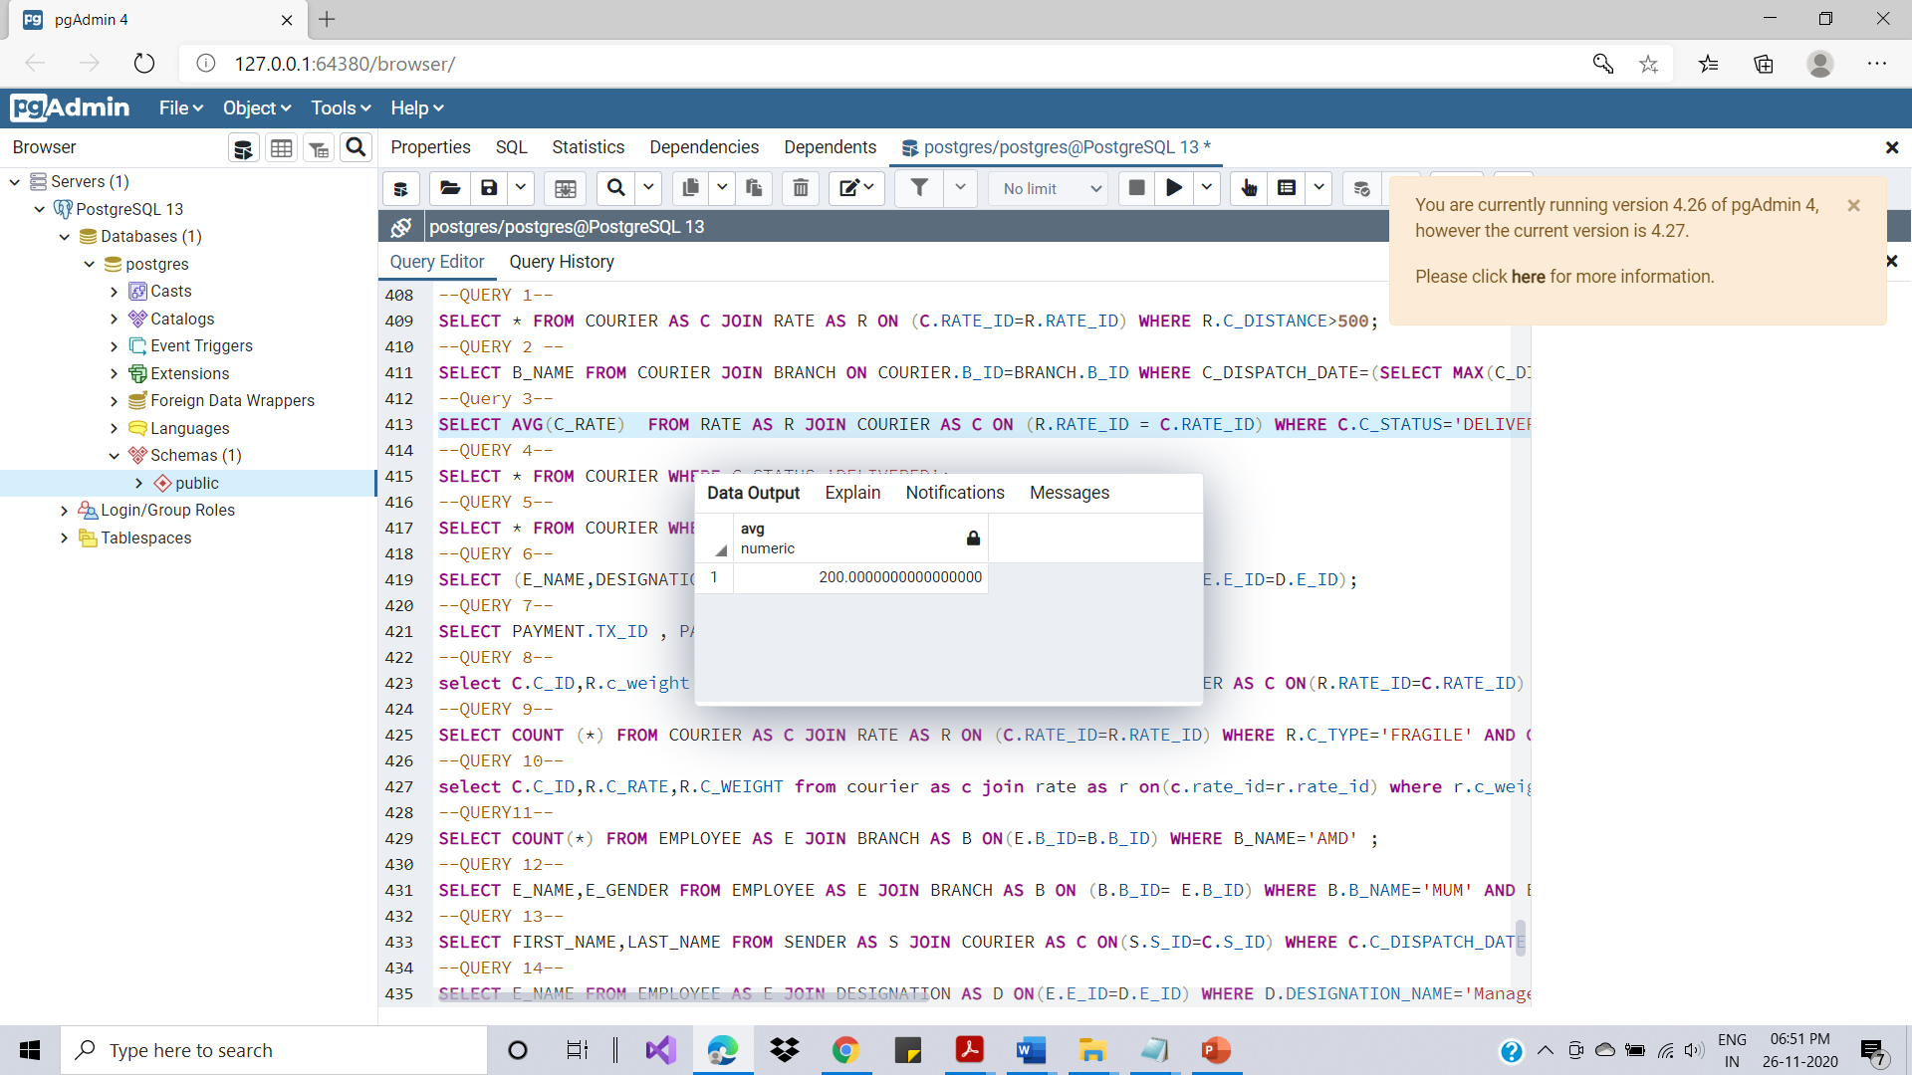
Functional Requirement-5
5. The average cost of couriers in September.
Link: FR5(Click here to open)

Slide 11
Conclusion
Main objective of our database management system is to maintain day to day activities of courier related transactions like sender and receiver information.
It will connect all the branches to use uniform database for courier so that information can be used from any branch.

Slide 12
THANK YOU

